Slide 1
Chapter 1: Introduction & Chapter 2: Operating-System Structures NARZU TARANNUM(NAT) LECTURER DEPT. OF CSE, BRAC UNIVERSITY

Slide 2
Objectives
To provide a grand tour of the major operating systems components
To provide coverage of basic computer system organization
To describe the services an operating system provides to users, processes, and other systems
To discuss the various ways of structuring an operating system

Slide 3
What is an Operating System?
A program that acts as an intermediary between a user of a computer and the computer hardware.
Operating system goals:
Execute user programs and make solving user problems easier.
Make the computer system convenient to use.
Use the computer hardware in an efficient manner.

Slide 4
What Operating Systems Do
OS is a resource allocator
Manages and allocate all resources
Decides between conflicting requests for efficient and fair resource use
OS is a control program
controls the execution of user programs and operations of I/O devices .
Kernel – the one program running at all times (all else being application programs).

Slide 5
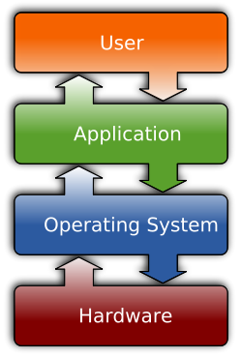
Software
The two most common types of software are :
System software
Application software.
What is System Software?
System Software refers to the operating system and all utility programs that manage computer resources at a low level. Systems software includes compilers, loaders, linkers, and debuggers.
What is Application Software?
Applications software comprises programs designed for an end user, such as word processors, database systems, and spreadsheet programs.

Slide 6
Computer System Structure
Computer system can be divided into four components
Hardware – provides basic computing resources
CPU, memory, I/O devices
Operating system
Controls and coordinates use of hardware among various applications and users
Application programs – define the ways in which the system resources are used to solve the computing problems of the users
Word processors, compilers, web browsers, database systems, video games
Users
People, machines, other computers

Slide 7
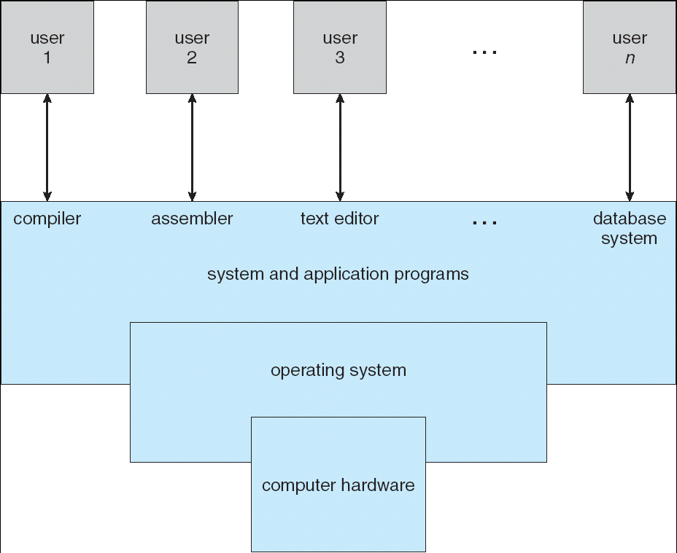
Four Components of a Computer System

Slide 8
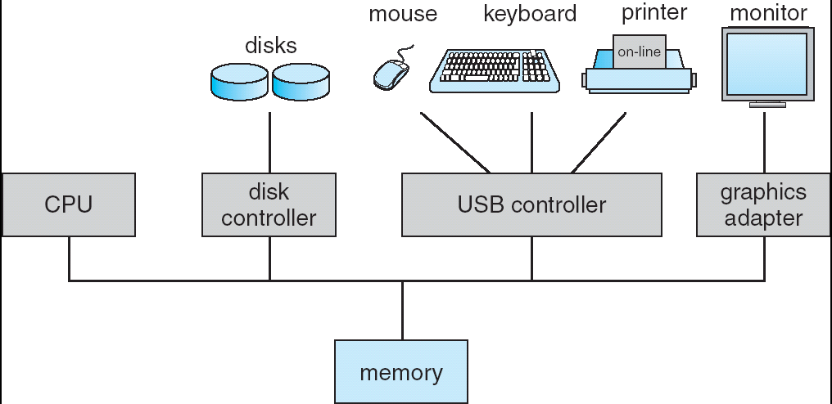
Computer System Organization
Computer-system operation
One or more CPUs, Memory, device controllers connect through a common bus which is called system bus.

Slide 9
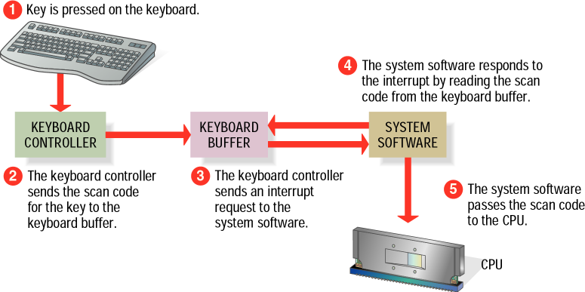
Computer-System Operation
I/O devices and the CPU can execute concurrently.
Each device controller is in charge of a particular device type.
Each device controller has a local buffer. [store (data) in a buffer while it is being processed or transferred.]
CPU moves data from/to main memory to/from local buffers
Device controller informs CPU that it has finished its operation by causing an interrupt.
Notes:
store (data) in a buffer while it is being processed or transferred.
store (data) in a buffer while it is being processed or transferred.
store (data) in a buffer while it is being processed or transferred.
store (data) in a buffer while it is being processed or transferred.

Slide 10
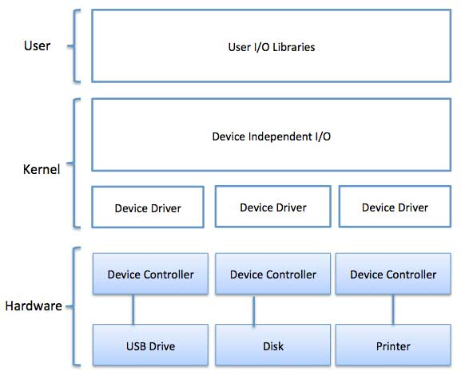
Device driver and Device controller
Notes:
Device Driver for each device controller to manage I/O Provides uniform interface between controller and kernel.

Slide 11
Common Functions of Interrupts
Interrupts transfers control to the interrupt service routine generally, through the interrupt vector, which contains the addresses of all the service routines.
Interrupt architecture must save the address of the interrupted instruction.
A trap is a software-generated interrupt caused either by an error or a user request.
An operating system is interrupt driven.

Slide 12
Direct Memory Access (DMA) Structure
Used for high-speed I/O devices able to transmit information at close to memory speeds.
Device controller transfers blocks of data from buffer storage directly to main memory without CPU intervention.
Only one interrupt is generated per block, rather than the one interrupt per byte.

Slide 13
Storage Structure
Main memory – only large storage media that the CPU can access directly
Random access
Typically volatile
Secondary storage – extension of main memory that provides large nonvolatile storage capacity

Slide 14
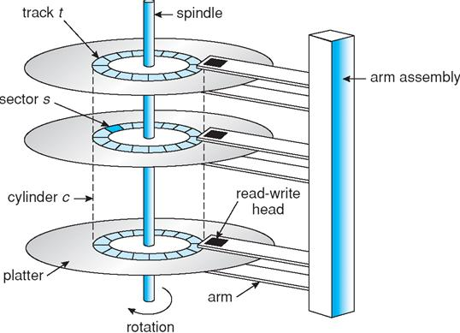
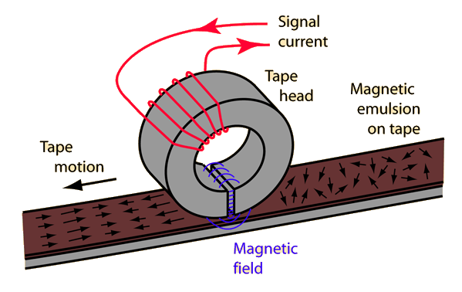
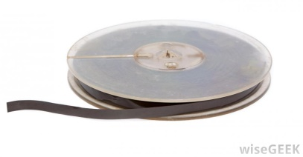
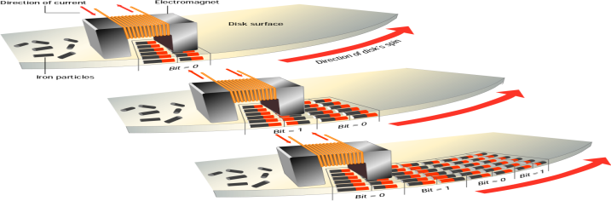
Storage Structure
Hard disks – rigid metal or glass platters covered with magnetic recording material
Disk surface is logically divided into tracks, which are subdivided into sectors
The disk controller determines the logical interaction between the device and the computer
Solid-state disks – faster than hard disks, nonvolatile
Various technologies
Becoming more popular
Magnetic Tapes

Slide 15
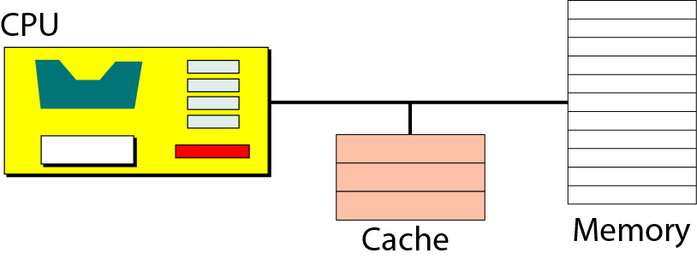
Storage Hierarchy
Storage systems organized in hierarchy.
Speed
Cost
Volatility
Size
Caching – Information in use copied from slower to faster storage temporarily

Slide 16
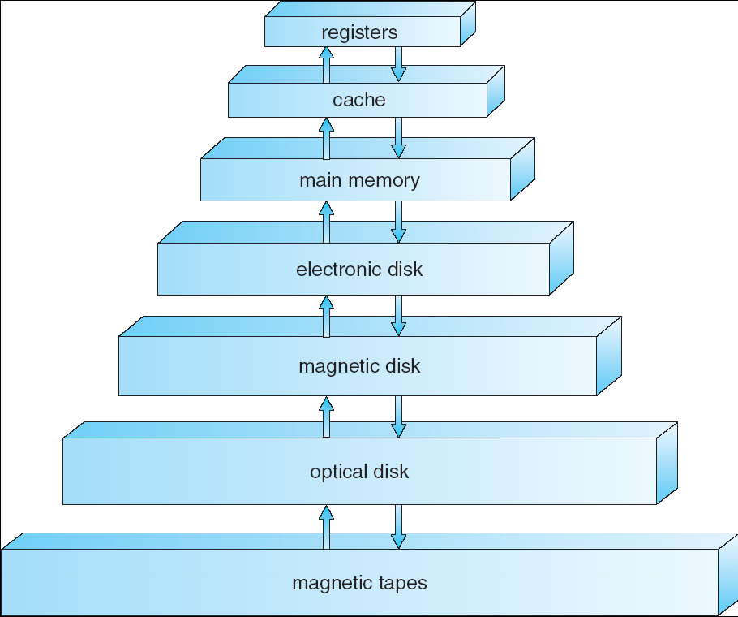
Storage-Device Hierarchy

Slide 17
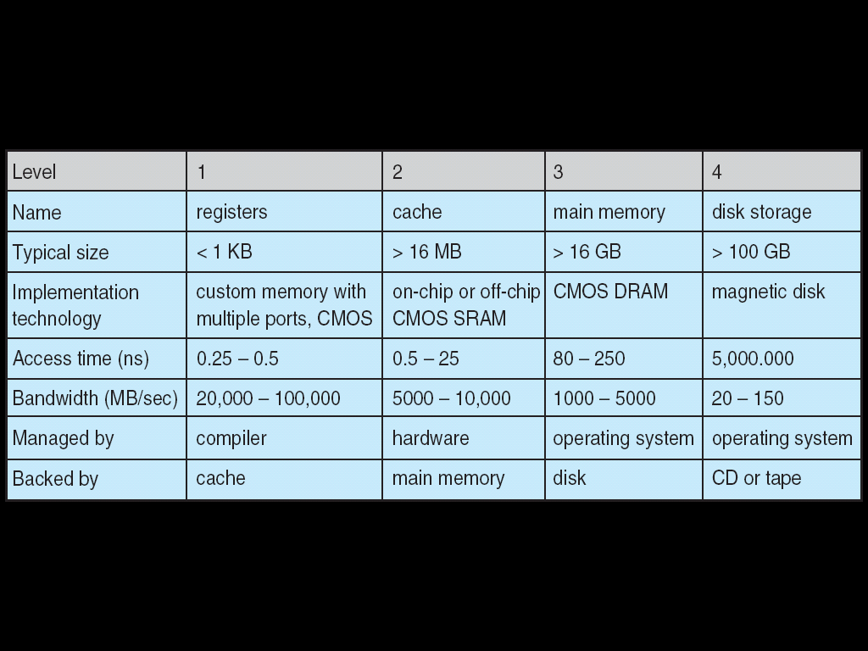
Performance of Various Levels of Storage
Movement between levels of storage hierarchy can be explicit or implicit

Slide 18
Multiprogrammed Batch Systems
Multiprogramming needed for efficiency
Single user cannot keep CPU and I/O devices busy at all times
Multiprogramming organizes jobs (code and data) so CPU always has one to execute
A subset of total jobs in system is kept in memory
When it has to wait (for I/O for example), OS switches to another job

Slide 19
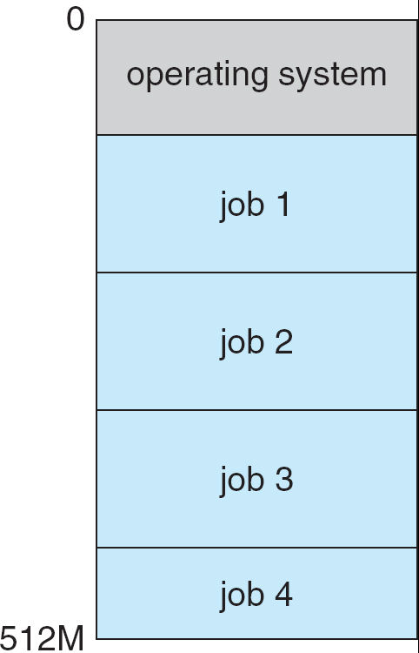
Memory Layout for Multiprogrammed System
OS Features Needed for Multiprogramming:
I/O routine supplied by the system.
Memory management – the system must allocate the memory to several jobs.
CPU scheduling – the system must choose among several jobs ready to run.
Allocation of devices.

Slide 20
Time-Sharing Systems–Interactive Computing
Timesharing (multitasking) is logical extension in which CPU switches jobs so frequently that users can interact with each job while it is running, creating interactive computing
Response time should be < 1 second
Each user has at least one program executing in memory. A program loaded into memory and executing is called ⇨process
⇨ Job scheduling
⇨ CPU scheduling
If processes don’t fit in memory, swapping moves them in and out to run from main memory achieving this goal is virtual memory.

Slide 21
Operating-System operations
With sharing many processes could be adversely affected by a bug in one program. Since the operating system and the users share the hardware and software resources of the computer system, a properly designed OS must ensure that an incorrect program can not run and also can not cause other programs to execute incorrectly.
Hardware generates interrupt.
Many errors detected by hardware can be handled by OS.
Software error handled by exception or trap.
In order to ensure the proper execution of operating system, we must be able to distinguish between the execution of the operating system code and user defined code.

Slide 22
Hardware Protection
The approach taken by most computer system is to provide hardware support that allows us to differentiate among various modes of execution.
Dual-mode operation allows OS to protect itself and other system components
User mode (1) and Kernel/Monitor/System mode (0)
Mode bit provided by hardware
Provides ability to distinguish when system is running user code or system code
Some instructions designated as privileged, only executable in system mode
System call changes mode to kernel, return from call resets it to user

Slide 23
Hardware Protection
Memory protection
I/O Protection
To prevent a user from performing illegal I/O, we define all I/O instructions to be privileged instruction.
CPU Protection
We must prevent a user program getting stuck in an infinite loop and never returning the control to the OS. To accomplish this goal, we can use a timer.

Slide 24
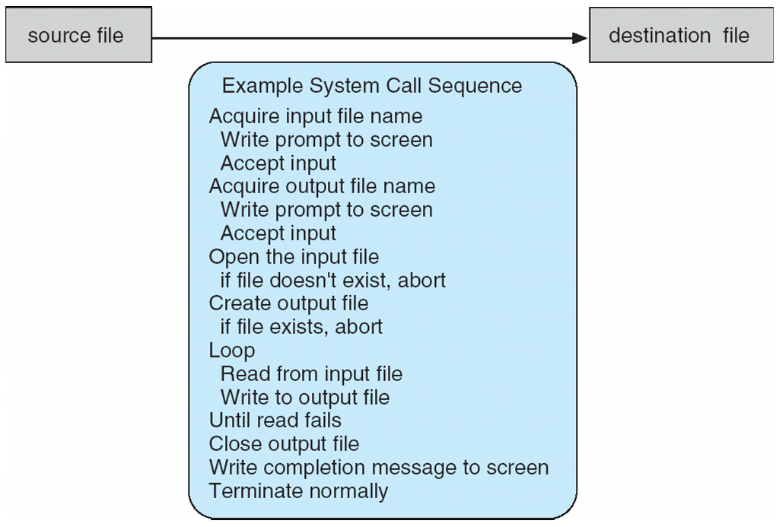
System Calls
Programming interface to the services provided by the OS
Typically written in a high-level language (C or C++)
Mostly accessed by programs via a high-level Application Programming Interface (API) rather than direct system call use
System call sequence to copy the contents of one file to another file
Note that the system-call names used throughout this text are generic

Slide 25
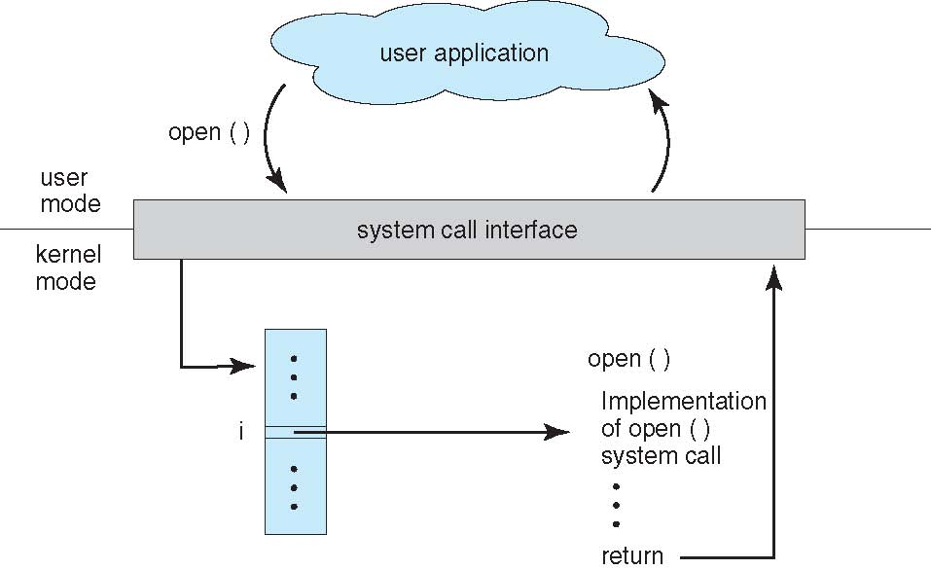
System Call Implementation
Typically, a number associated with each system call
System-call interface maintains a table indexed according to these numbers
The system call interface invokes the intended system call in OS kernel and returns status of the system call and any return values
The caller need know nothing about how the system call is implemented
API – System Call – OS Relationship

Slide 26
Types of System Calls
Process control
create process, terminate process
end, abort
load, execute
get process attributes, set process attributes
wait for time
wait event, signal event
allocate and free memory
Dump memory if error
Debugger for determining bugs, single step execution
Locks for managing access to shared data between processes
Device management
request device, release device
read, write, reposition
get device attributes, set device attributes
logically attach or detach devices
File management
create file, delete file
open, close file
read, write, reposition
get and set file attributes
Protection
Control access to resources
Get and set permissions
Allow and deny user access
Information maintenance
get time or date, set time or date
get system data, set system data
get and set process, file, or device attributes
Communications
create, delete communication connection
send, receive messages
etc

Slide 27
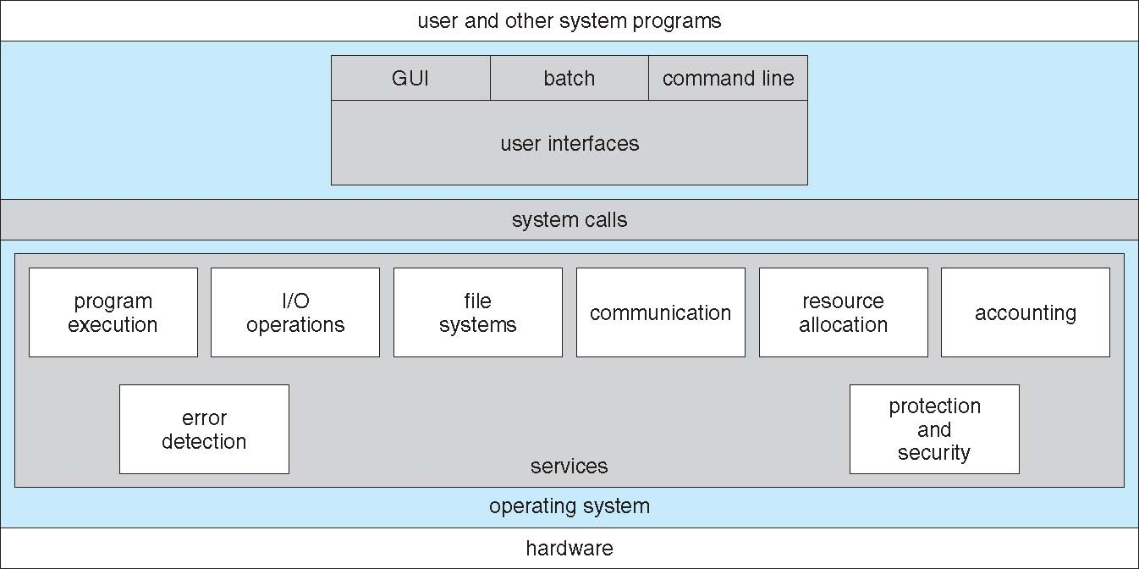
A View of Operating System Services

Slide 28
Operating System Services
Operating systems provide an environment for execution of programs and services to programs and users
One set of operating-system services provides functions that are helpful to the user:
User interface - Almost all operating systems have a user interface (UI).
Varies between Command-Line (CLI), Graphics User Interface (GUI), Batch interface- in which commands and directives to control those commands are entered into files, and those files are executed.
Program execution - The system must be able to load a program into memory and to run that program, end execution, either normally or abnormally (indicating error)
I/O operations - A running program may require I/O, which may involve a file or an I/O device

Slide 29
Operating System Services (Cont.)
One set of operating-system services provides functions that are helpful to the user (Cont.):
File-system manipulation - The file system is of particular interest. Programs need to read and write files and directories, create and delete them, search them, list file Information, permission management.
Communications – Processes may exchange information, on the same computer or between computers over a network
Communications may be via shared memory or through message passing (packets moved by the OS)
Error detection – OS needs to be constantly aware of possible errors
May occur in the CPU and memory hardware, in I/O devices, in user program
For each type of error, OS should take the appropriate action to ensure correct and consistent computing
Debugging facilities can greatly enhance the user’s and programmer’s abilities to efficiently use the system

Slide 30
Operating System Services (Cont.)
Another set of OS functions exists for ensuring the efficient operation of the system itself via resource sharing
Resource allocation - When multiple users or multiple jobs running concurrently, resources must be allocated to each of them
Many types of resources - CPU cycles, main memory, file storage, I/O devices.
Accounting - To keep track of which users use how much and what kinds of computer resources
Protection and security - The owners of information stored in a multiuser or networked computer system may want to control use of that information, concurrent processes should not interfere with each other
Protection involves ensuring that all access to system resources is controlled
Security of the system from outsiders requires user authentication, extends to defending external I/O devices from invalid access attempts

Slide 31
OS Structure
An operating system is a construct that allows the user application programs to interact with the system hardware. Since the operating system is such a complex structure, it should be created with utmost care so it can be used and modified easily. An easy way to do this is to create the operating system in parts. Each of these parts should be well defined with clear inputs, outputs and functions.
General-purpose OS is very large program
Various ways to structure ones
Simple structure/ Monolithic kernel – MS-DOS
Layered – an abstraction
Microkernel -Mach

Slide 32
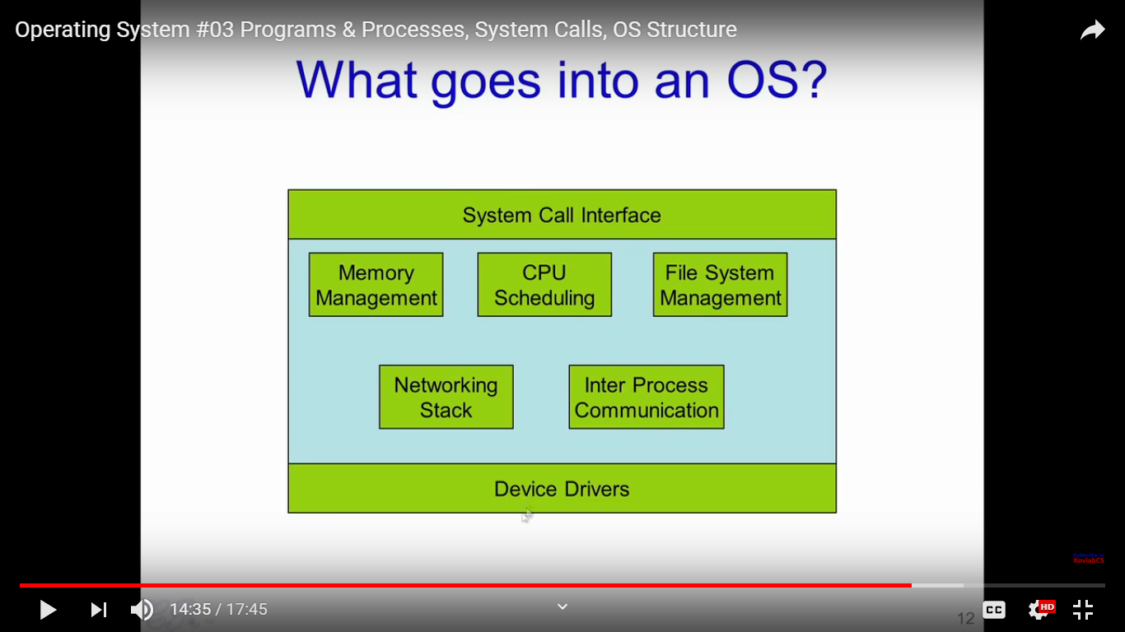
OS Structure

Slide 33
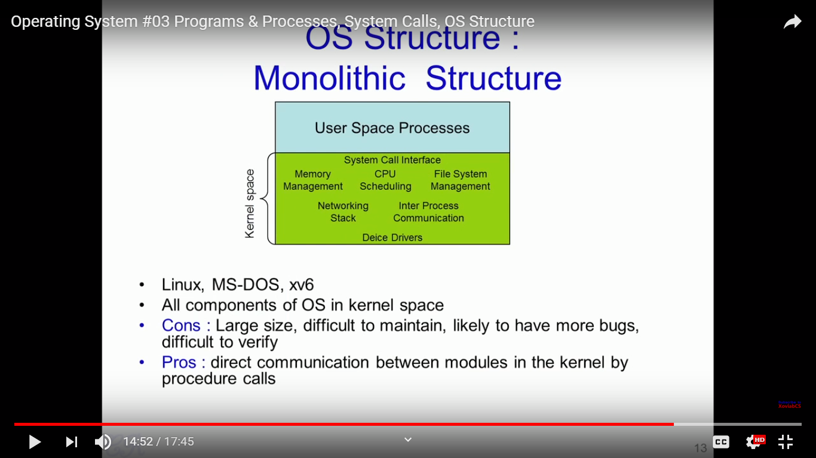
OS Structure: Monolithic
Not divided into modules

Slide 34
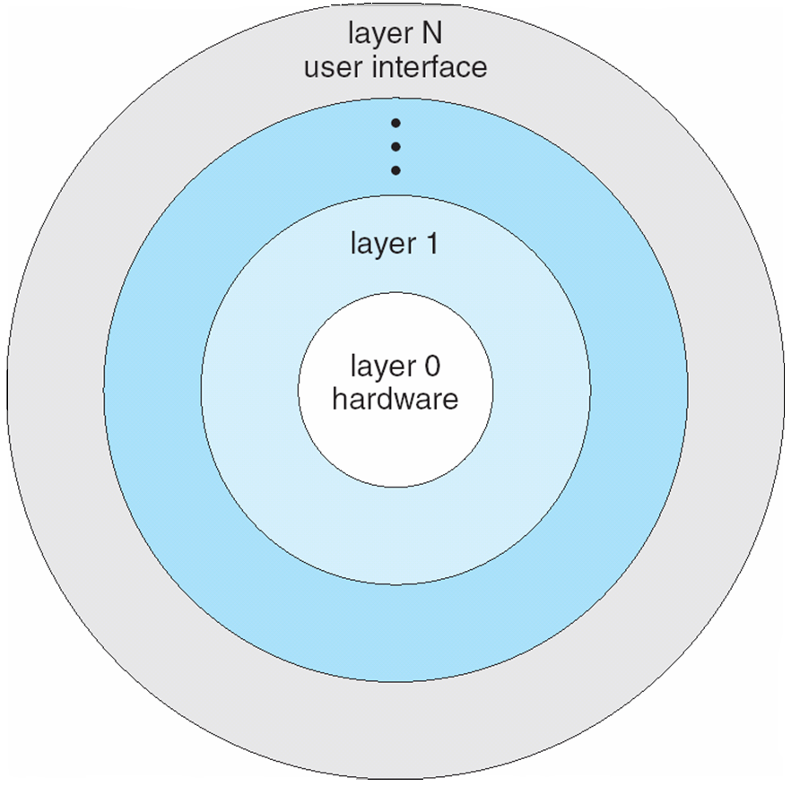
OS Structure: Layered
In this, the bottom layer is the hardware and the topmost layer is the user interface.
Each upper layer is built on the bottom layer. All the layers hide some structures, operations etc. from their upper layers.
With modularity, layers are selected such that each uses functions (operations) and services of only lower-level layers
One problem with the layered structure is that each layer needs to be carefully defined.

Slide 35
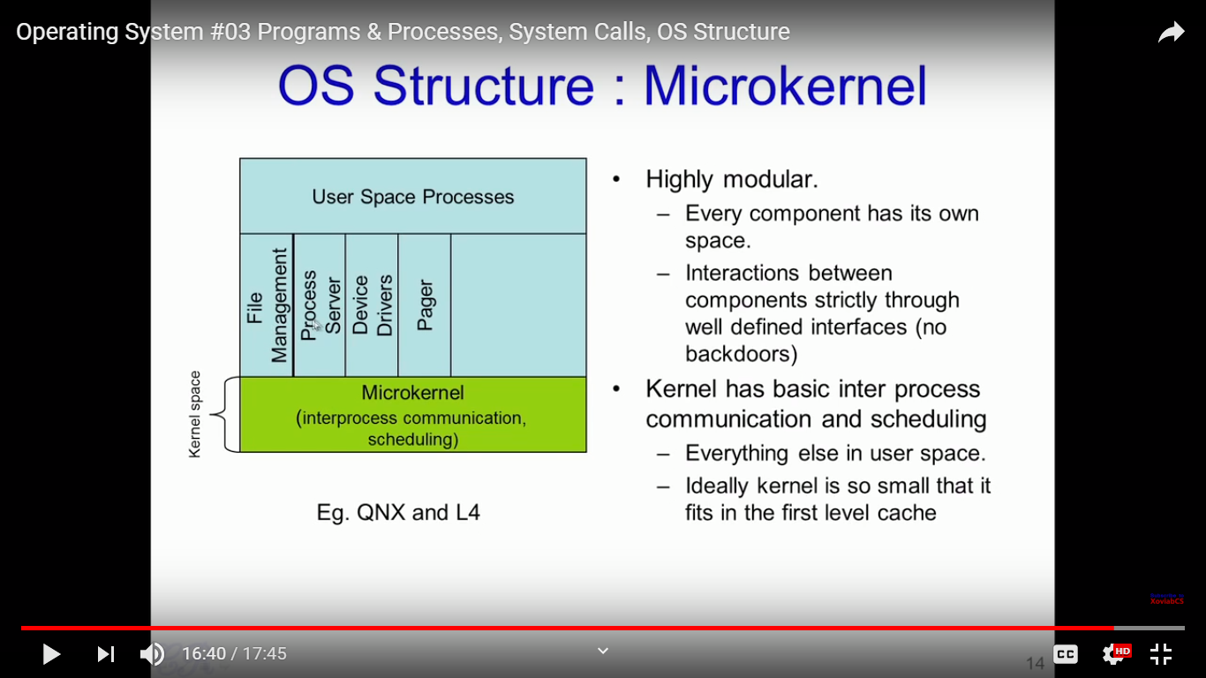
OS Structure: Microkernel
Notes:
Mac OS X kernel (Darwin) partly based on Mach
Benefits:
Easier to extend a microkernel
More reliable (less code is running in kernel mode)
More secure
Detriments:
Performance overhead of user space to kernel space communication

Slide 36
OS Structure: Microkernel
Mac OS X kernel (Darwin) partly based on Mach
Benefits:
Easier to extend a microkernel
More reliable (less code is running in kernel mode)
More secure
Detriments:
Performance overhead of user space to kernel space communication

Slide 37
Chapter 3: Processes
break

Slide 38
Process Management
A process is a program in execution. It is a unit of work within the system. Program is a passive entity stored on disk (executable file), process is an active entity.
Process needs resources to accomplish its task
CPU, memory, I/O, files
Initialization data
Program becomes process when executable file loaded into memory.
One program can be several processes
Consider multiple users executing the same program
Process termination requires reclaim of any reusable resources
Processes maybe single-threaded or multi-threaded
Process executes instructions sequentially, one at a time, until completion
Typically a system has many processes running concurrently on one or more CPUs
Concurrency by multiplexing the CPUs among the processes / threads

Slide 39
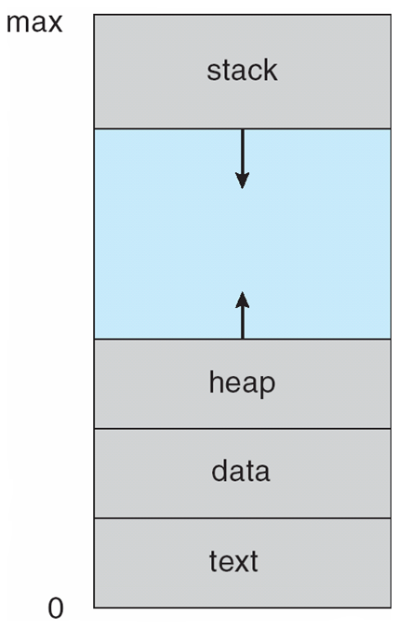
Multiple parts of a process
The program code, also called text section
Current activity including program counter, processor registers
Stack containing temporary data, function parameters, return addresses, local variables, etc.
Data section containing global variables
Heap containing memory dynamically allocated during run time
Process in Memory

Slide 40
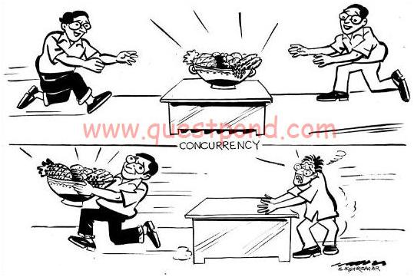
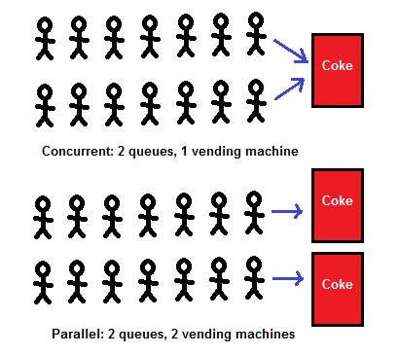
Concurrency: the fact of two or more events or circumstances happening or existing at the same time
Concurrency means multiple computations are happening at the same time. Concurrency is everywhere in modern programming, whether we like it or not:
Multiple computers in a network
Multiple applications running on one computer
Multiple processors in a computer (today, often multiple processor cores on a single chip)

Slide 41
Process Management Activities
The operating system is responsible for the following activities in connection with process management:
Creating and deleting both user and system processes
Suspending and resuming processes
Providing mechanisms for process synchronization
Providing mechanisms for process communication
Providing mechanisms for deadlock handling

Slide 42
Memory Management Activities
All data in memory before and after processing
All instructions in memory in order to execute
Memory management determines what is in memory when
Optimizing CPU utilization.
The operating system is responsible for the following activities in connection with memory management(Memory management activities):
Keeping track of which parts of memory are currently being used and by whom
Deciding which processes (or parts thereof) and data to move into and out of memory
Allocating and de-allocating memory space as needed

Slide 43
File Management Activities
A file is a collection of related information defined by its creator.
OS provides uniform, logical view of information storage
OS shows the logical view of the abstract of physical files.
Each medium is controlled by device (i.e., disk drive, tape drive)
File-System management
Files usually organized into directories
Access control on most systems to determine who can access what
The operating system is responsible for the following activities in connection with file management:
Creating and deleting files and directories
Manipulate files and directories
Mapping files onto secondary storage
Backup files onto stable (non-volatile) storage media

Slide 44
Mass-Storage Management Activities
Because main memory is too small to accommodate all data and programs, and its data is lost when power is lost, the computer system must provide secondary storage to back up main memory.
Proper management of disk storage is of central importance to a computer system.
The operating system is responsible for the following activities in connection with disk management:
Free-space management
Storage allocation
Disk scheduling

Slide 45
I/O Management Activities
One purpose of OS is to hide peculiarities of hardware devices from the user
I/O subsystem responsible for
Memory management of I/O including buffering (storing data temporarily while it is being transferred), caching (storing parts of data in faster storage for performance), spooling (the overlapping of output of one job with input of other jobs)
General device-driver interface

Slide 46
Protection and Security
Protection – refers to a mechanism for controlling the access of programs, processes or user’s to the resources defined by a computer systems.
Security – defense of the system against internal and external attacks.

Slide 47
End

